Slide 1

CONCEPT MILESTONE
Travis Moore
thedevilswaffle@gmail.com
www.thedevilswaffle.com
GAT 316 Fall 2016
Section B
Professor: Richard Rowan

Slide 2

CONCEPTS OVERVIEW
SUPER SPACE SCAVENGERS
TEMPLE OF LOOT

Slide 4
Super Space Scavengers is a top-down 3D multiplayer team-based game where players race to strip all valuables aboard an abandoned space ship before it explodes!

Slide 5
Super Space Scavengers is a top-down 3D multiplayer team-based game where players race to strip all valuables aboard an abandoned space ship before it explodes!
Not based off of any previous project (in Auston words: “it’s new)

Slide 6
GAMEPLAY
Players interact with the environment to enable them to access locked areas of the ship or prevent others from accessing areas of the ship.

Slide 7
GAMEPLAY
How is this done?

Slide 8
GAMEPLAY
How is this done?
Blowing up walls with your blaster

Slide 9
GAMEPLAY
How is this done?
Blowing up walls with your blaster
Activating switches that can:

Slide 10
GAMEPLAY
How is this done?
Blowing up walls with your blaster
Activating switches that can:
Release the airlocks in the cargo bay

Slide 11
GAMEPLAY
How is this done?
Blowing up walls with your blaster
Activating switches that can:
Release the airlocks in the cargo bay
Unleash angry prisoners locked in the brig

Slide 12
GAMEPLAY
How is this done?
Blowing up walls with your blaster
Activating switches that can:
Release the airlocks in the cargo bay
Unleash angry prisoners locked in the brig
Initiate the self-destruct sequence early

Slide 13
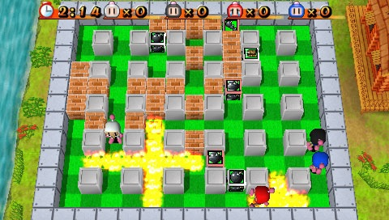
GAMEPLAY
Basically the game is an excuse for me to experiment with making random systems of death and chaos in the style of a Bomberman game.

Slide 14
FEATURES
3D Top Down Camera / Split Screen
2D Movement & Mechanics
Simple Controls – Blaster and Pickup Items
Interactive Systems
Humorous & Absurd Deaths
Team-Based Competitive Gameplay

Slide 15
telefrag d
’

Slide 16
Telefrag’d is a top-down 3D multiplayer action arcade game that pits 2 – 4 players against one another in a hazard filled arena.

Slide 17
Telefrag’d is a top-down 3D multiplayer action arcade game that pits 2 – 4 players against one another in a hazard filled arena.
Based off a previous GAT project, Reflect 3D

Slide 18
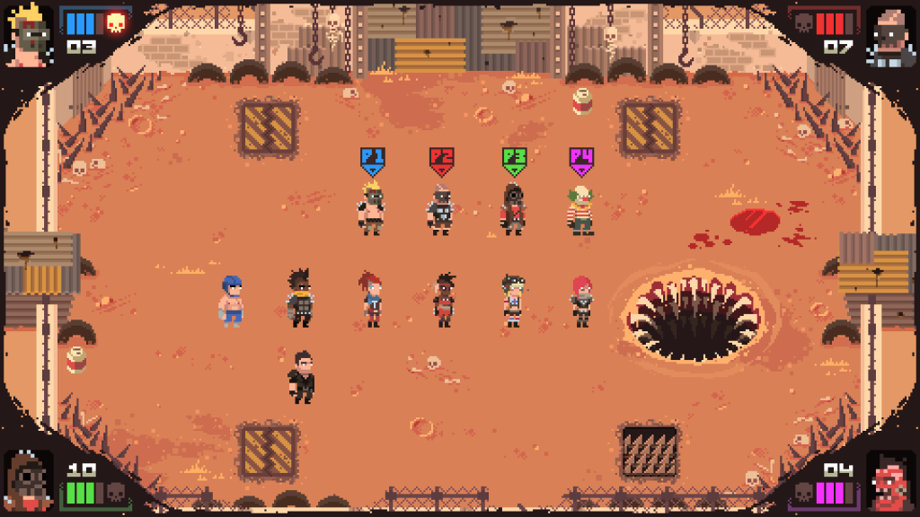
GAMEPLAY
Destroy other players by bumping them into hazards or teleporting into them.
Similar to the gameplay of Super Splataclysm

Slide 19
GAMEPLAY
Each player has two abilities:
Teleport and Shield

Slide 20
GAMEPLAY
Teleport
3 rapid short distance teleports

Slide 21
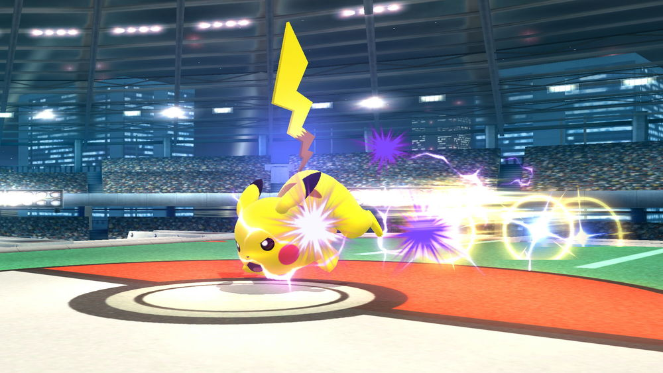
GAMEPLAY
Teleport
3 rapid short distance teleports
Like Pikachu’s quick attack in Super Smash Bros.

Slide 22
GAMEPLAY
Teleport
3 rapid short distance teleports
Like Pikachu’s quick attack in Super Smash Bros.
Teleporting into an opponent destroys that opponent (yay!)

Slide 23
GAMEPLAY
Shield
Instantly halts momentum

Slide 24
GAMEPLAY
Shield
Instantly halts momentum
Repels any incoming projectiles and teleporting players away in another direction

Slide 25
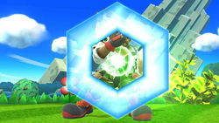
GAMEPLAY
Shield
Instantly halts momentum
Repels any incoming projectiles and teleporting players away in another direction
Think Fox’s reflector in Super Smash Bros.

Slide 26
FEATURES
3D Top Down Camera
2D Movement & Mechanics
Simple Controls – Teleporting & Shield
Arena Filled with Hazards
Humorous & Absurd Deaths
Quick, Competitive Gameplay

Slide 28
Temple of Loot is a top-down 3D asymmetrical multiplayer action
game set in a trap-filled temple.

Slide 29
Temple of Loot is a top-down 3D asymmetrical multiplayer action
game set in a trap-filled temple.
This concept is based off my GAT board game, Temple of Loot

Slide 30
GAMEPLAY - EXPLORERS
2 Explorers compete against each other to steal the most loot from the temple, or each other, before time is up or they lose all of their lives.

Slide 31
GAMEPLAY - EXPLORERS
2 Explorers compete against each other to steal the most loot from the temple, or each other, before time is up or they lose all of their lives.
The player with the most loot wins!

Slide 32
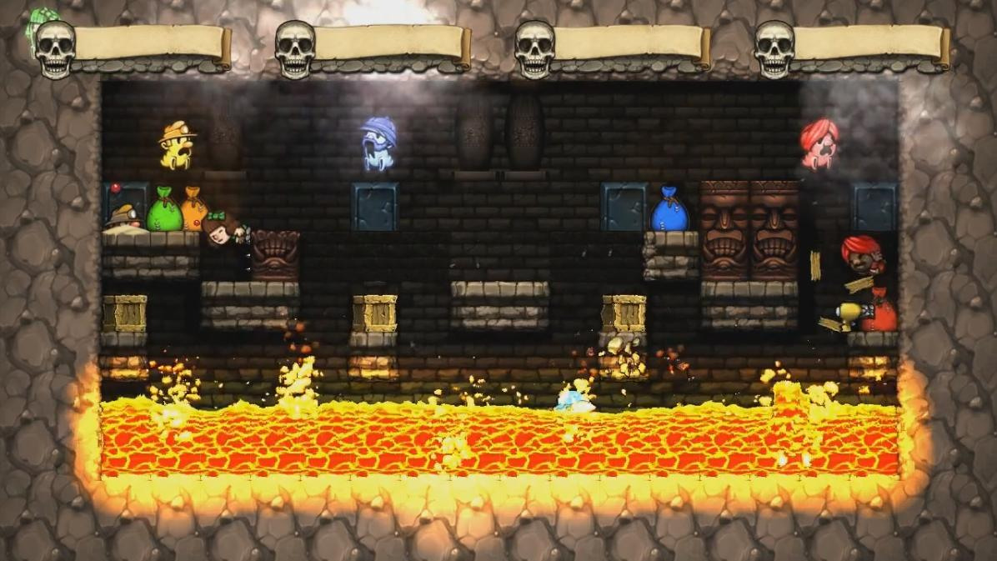
GAMEPLAY - EXPLORERS
2 Explorers compete against each other to steal the most loot from the temple, or each other, before time is up or they lose all of their lives.
The player with the most loot wins!
Think a sort of competitive version of Spelunky

Slide 33
GAMEPLAY - EXPLORERS
Explorer abilities include:

Slide 34
GAMEPLAY - EXPLORERS
Explorer abilities include:
Picking Up Loot

Slide 35
GAMEPLAY - EXPLORERS
Explorer abilities include:
Picking Up Loot
Using limited use items

Slide 36
GAMEPLAY - EXPLORERS
Explorer abilities include:
Picking Up Loot
Using limited use items
Pick axe to break walls

Slide 37
GAMEPLAY - EXPLORERS
Explorer abilities include:
Picking Up Loot
Using limited use items
Pick axe to break walls
Placing bridges to clear gaps

Slide 38
GAMEPLAY - EXPLORERS
Explorer abilities include:
Picking Up Loot
Using limited use items
Pick axe to break walls
Placing bridges to clear gaps
Running Away

Slide 39
GAMEPLAY - EXPLORERS
Explorer abilities include:
Picking Up Loot
Using limited use items
Pick axe to break walls
Placing bridges to clear gaps
Running Away
(it is a dangerous temple, after all)

Slide 40
GAMEPLAY - MUMMY
The mummy must prevent the explorers from stealing from their temple

Slide 41
GAMEPLAY - MUMMY
The mummy must prevent the explorers from stealing from their temple
Abilities include:

Slide 42
GAMEPLAY - MUMMY
The mummy must prevent the explorers from stealing from their temple
Abilities include:
Walls

Slide 43
GAMEPLAY - MUMMY
The mummy must prevent the explorers from stealing from their temple
Abilities include:
Walls
Enemies

Slide 44
GAMEPLAY - MUMMY
The mummy must prevent the explorers from stealing from their temple
Abilities include:
Walls
Enemies
Traps

Slide 45
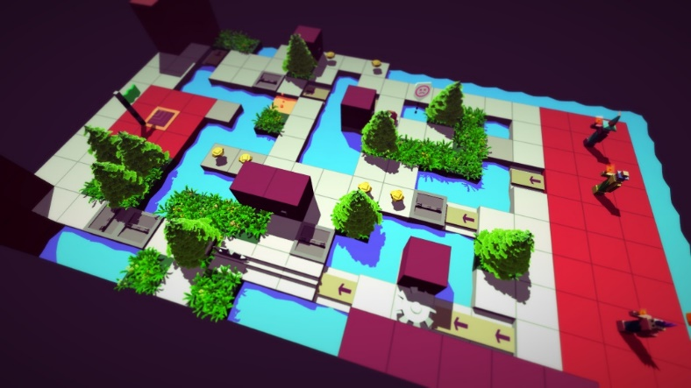
GAMEPLAY - MUMMY
The mummy must prevent the explorers from stealing from their temple
Abilities include:
Walls
Enemies
Traps
Think Trappers Delight

Slide 46
GAMEPLAY - MUMMY
The mummy must prevent the explorers from stealing from their temple
Abilities include:
Walls
Enemies
Traps
Think Trappers Delight
The mummy wins if both explorers lose all their lives.

Slide 47
FEATURES
3D Top Down Camera / Split Screen
2D Movement & Mechanics
Simple Controls
Traps, walls, and enemies (oh my!)
Humorous & Absurd Deaths
Asymmetric, Competitive Gameplay

Slide 48
Chosen Concept
I’ll be pursuing development on:
TEMPLE OF LOOT

Slide 49
Risks & Mitigations
All 3 of these concepts share similar mechanical features:
3D Top-down Camera
2D Mechanics
Multiplayer
Arcade Gameplay (life or timer-based game rounds)
This will allow me to focus on getting these systems done well while providing a safe fallback to easier concepts if my chosen concept doesn’t work out as well.

Slide 50
THANK YOU!
Travis Moore
thedevilswaffle@gmail.com
www.thedevilswaffle.com
GAT 316 Fall 2016
Section B
Professor: Richard Rowan

